Slide 1


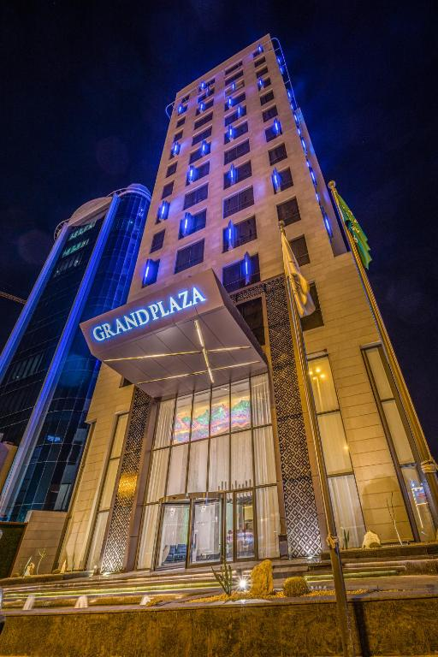
Grand Plaza Hotel Management System
Welcome to an overview of our hotel management solution.

Slide 2
TEAM MEMBERS
Team leader
KAWSAR
ID : 2243081198
Md Saiful Islam
ID: 2233081220
Tahsinul Islam imrose
ID: 2233081222
Junaidur rahman
ID: 2233081237

Slide 3

Dashboard: Daily Overview
15
84%
2
1
Total Rooms
Occupancy
Check-ins Today
Check-outs Today
+2 this month
6 rooms occupied
+1 yesterday
-2 yesterday

Slide 4
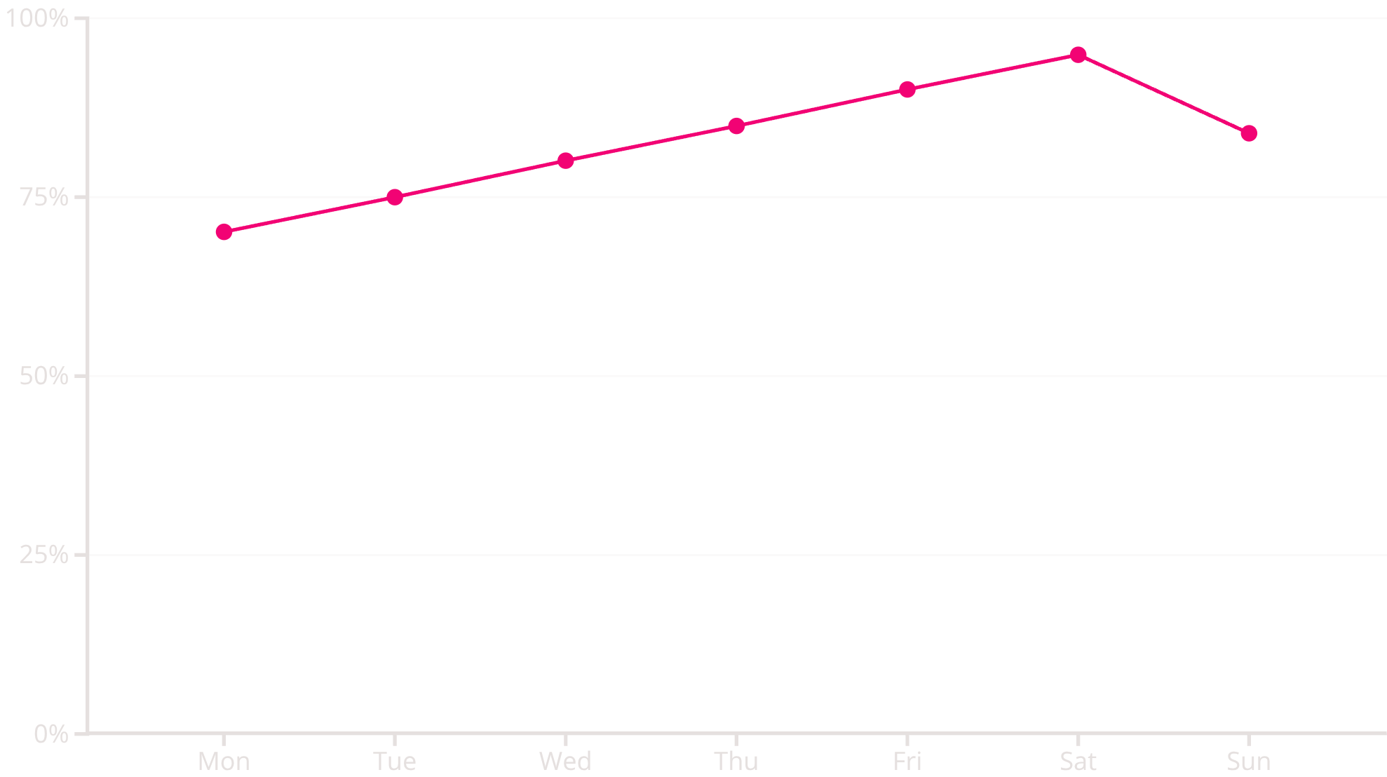
Real-time Occupancy & Bookings
Occupancy Rate This Week
Recent Bookings
David Brown - Room 305 (Pending)
Sophia Chen - Room 103 (Confirmed)
John Smith - Room 102 (Confirmed)
Maria Garcia - Room 202 (Confirmed)
Robert Johnson - Room 204 (Confirmed)
View All

Slide 5
Seamless Booking Management
Effortlessly manage room reservations, check-ins, and guest details.
#1001
John Smith
Room 102
Dec 6, 2025
Dec 7, 2025
$300.00
Confirmed
#1002
Maria Garcia
Room 202
Dec 6, 2025
Dec 13, 2025
$1050.00
Confirmed
#1005
David Brown
Room 305
Dec 7, 2025
Dec 13, 2025
$900.00
#1007
James Miller
Room 203
Dec 5, 2025
Dec 6, 2025
$110.00
Cancelled

Slide 6
Efficient Room Management
View and manage all hotel rooms with real-time status updates.
101
Deluxe
1
$150
Available
wifi, tv, ac...
102
Standard
1
$100
Occupied
wifi, tv, ac
104
Standard
1
$100
Maintenance
wifi, tv
105
Deluxe
1
$150
Clearing
wifi, tv, ac...
201
Suite
2
$250
Available
wifi, tv, ac...

Slide 7
Comprehensive Guest Management
Maintain detailed guest information and booking history for personalized service.
#2001
John Smith
john@example.com
+1-555-1234
USA
1
#2002
Maria Garcia
maria@example.com
+34-555-5678
Spain
1
#2005
David Brown
david@example.com
+1-555-9999
Canada
1
#2006
Sophia Chen
sophia@example.com
+88-555-8888
China
1

Slide 8
Streamlined Billing & Invoicing
Generate invoices and manage payments with ease.
#5001
John Smith
#1001
Dec 6, 2025
Dec 7, 2025
$330.00
Paid
#5002
Maria Garcia
#1002
Dec 8, 2025
Dec 13, 2025
$1155.00
Paid
#5004
Emma Wilson
#1004
Dec 5, 2025
Dec 13, 2025
$1925.00
Pending
#5005
David Brown
#1005
Dec 6, 2025
Dec 13, 2025
$990.00
Pending

Slide 9
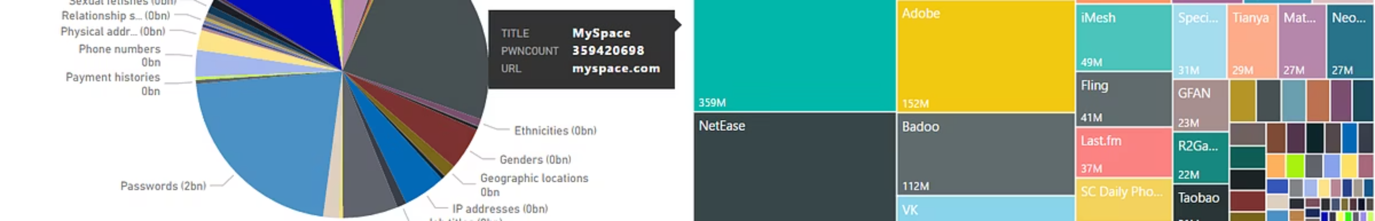

Powerful Reports & Analytics
Generate insightful reports to understand hotel performance and make data-driven decisions.
Occupancy Reports
Revenue Reports
Analyze daily, weekly, and monthly occupancy rates.
Track income from various sources and identify trends.
Guest Demographics
Booking Forecasts
Understand guest profiles and preferences.
Predict future demand and optimize pricing strategies.

Slide 10

Customizable System Settings
Configure system preferences to match your hotel's unique operations.
Hotel Information
Manage contact details and address.
Room Settings
Set default check-in/out times.
Notifications
Enable email and SMS alerts.
System Preferences
Auto-assign rooms, require deposits.

Slide 11




Secure & Reliable Operations
Our system ensures data integrity and provides essential backup and reset functionalities.
Export All Data
Securely backup your hotel's information.
Import Data
Seamlessly transfer existing records.
Reset All Data
Start fresh when needed.

Slide 12
Here’s Our Website Look Like

Slide 13
Thank You all…

